Slide 1
Martian Slope Stability
Group 2
Dalin Russell
Caleb Oakes
Jasmyn Harper

Slide 2
Martian Slope Stability
Earth vs Mars
Valles Marineris
Mechanisms of Slope Failure
Analysis of Slope Failures
Notes:
Location
Gravity
Water content
Layering
Volcanic deposits/ash deposit
Soil properties
Need way to estimate deeper soil properties

Slide 3
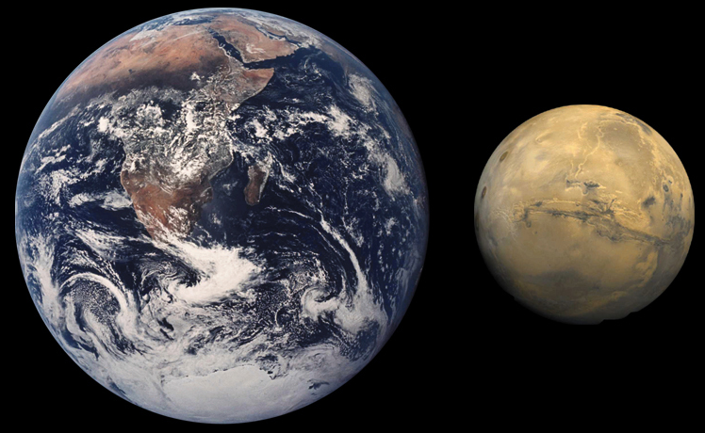
Differences between Earth and Mars
Notes:
Surficial qualities
Climate thin atmosphere
Average -94°F to 32°F
Surficial qualities
The top layer of soil is frozen increasing topsoil strength
Gravity
Earth 9.81 m/s2
Mars 3.71 m/s2
Soil properties
Layering of Basalt & Volcanic Ash

Slide 4
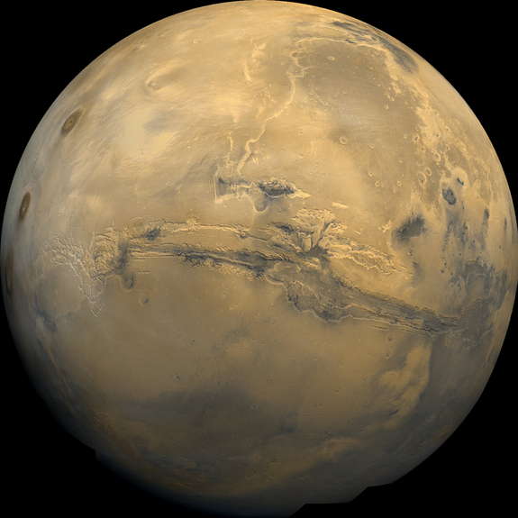
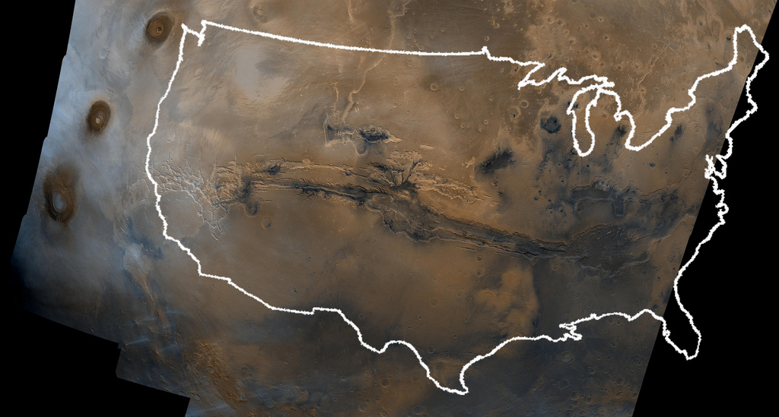
Valles Marineris
Info Source: http://mars.jpl.nasa.gov/gallery/atlas/valles-marineris.html
Pic source: US on mars http://photojournal.jpl.nasa.gov/catalog/?IDNumber=PIA00003
Mars planet http://www.space.com/20446-valles-marineris.html
Notes:
Along the martian equator
Most researchers agree that VM is a large tectonic “crack” in the martian crust which formed as the planet cooled. There area also traces of erosional forces from apparent channels formed by waters.
Valles Marineris
2500 miles long & 4 miles deep
20% of distance around mars
Grand Canyon
500 miles long & 1 mile deep
Rushing water eroded more of the canyon

Slide 5
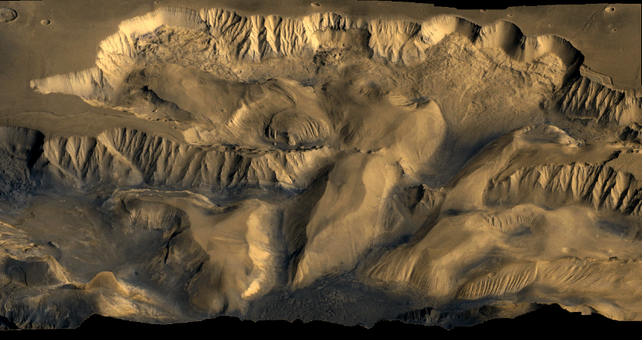
Mechanisms
Volcanoes
Larger than those of Earth
Tharsis Montes 16 miles tall about the state of Arizona
Y mountain is 0.75 miles tall
Mt Everest is 5.5 miles
Meteor Impact
Meteor collisions form enough energy to trigger slope failure
Marsquakes
Fault at bottom of Valles Marineris
Less seismically active than earth
http://pubs.usgs.gov/sim/3309/downloads/sim3309_sheet.pdf
Info Source:http://www.space.com/20133-olympus-mons-giant-mountain-of-mars.html
Pic source: http://www.space.com/20133-olympus-mons-giant-mountain-of-mars.html
http://en.wikipedia.org/wiki/Valles_Marineris
http://pubs.usgs.gov/sim/3309/downloads/sim3309_sheet.pdf
Notes:
Study of two major canyons Tithonium and Ius Chasmata
5 types of geomorphological features to classify different types of mass movements
Volcanoes
Larger than those of Earth
Tharsis Montes 16 miles tall about the state of Arizona
Y mountain is 0.75 miles tall
Mt Everest is 5.5 miles
Meteor Impact
Meteor collisions form enough energy to trigger slope failure
Marsquakes
Fault at bottom of Valles Marineris
Less seismically active than earth

Slide 6
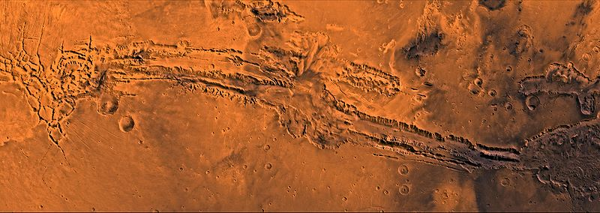
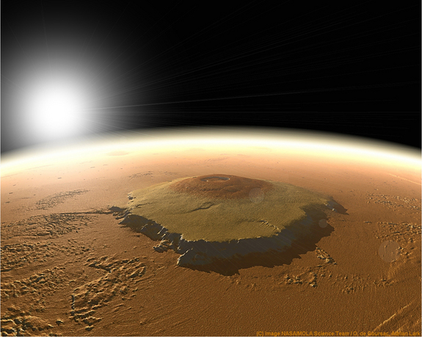
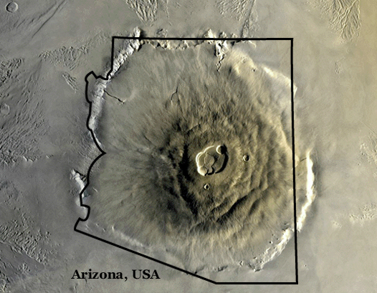
Mechanisms
Tharsis Montese
Volcanoes
Larger than those of Earth
Tharsis Montes 16 miles tall about the state of Arizona
Y mountain is 0.75 miles tall
Mt Everest is 5.5 miles
Meteor Impact
Meteor collisions form enough energy to trigger slope failure
Marsquakes
Fault at bottom of Valles Marineris
Less seismically active than earth
http://pubs.usgs.gov/sim/3309/downloads/sim3309_sheet.pdf
Info Source:http://www.space.com/20133-olympus-mons-giant-mountain-of-mars.html
Pic source: http://www.space.com/20133-olympus-mons-giant-mountain-of-mars.html
http://en.wikipedia.org/wiki/Valles_Marineris
http://pubs.usgs.gov/sim/3309/downloads/sim3309_sheet.pdf
Notes:
Study of two major canyons Tithonium and Ius Chasmata
5 types of geomorphological features to classify different types of mass movements
Volcanoes
Larger than those of Earth
Tharsis Montes 16 miles tall about the state of Arizona
Y mountain is 0.75 miles tall
Mt Everest is 5.5 miles
Meteor Impact
Meteor collisions form enough energy to trigger slope failure
Marsquakes
Fault at bottom of Valles Marineris
Less seismically active than earth

Slide 7
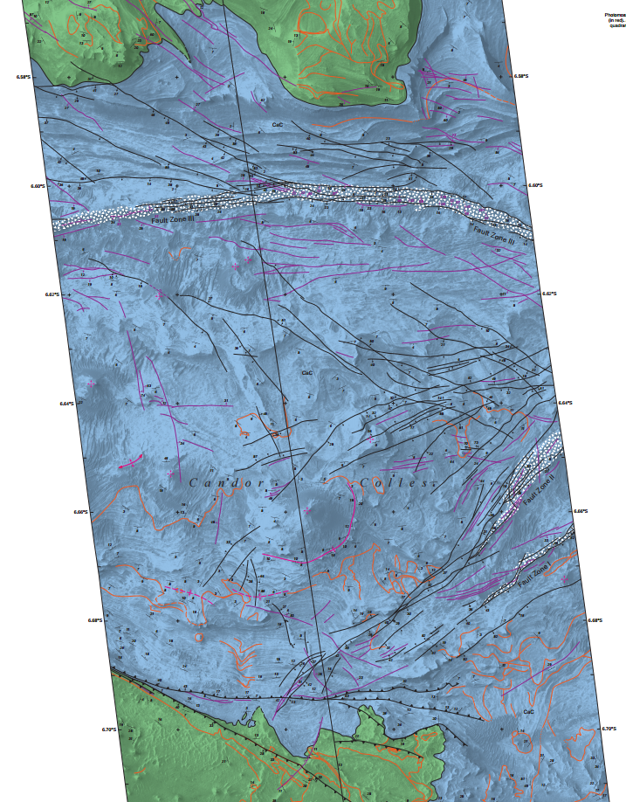
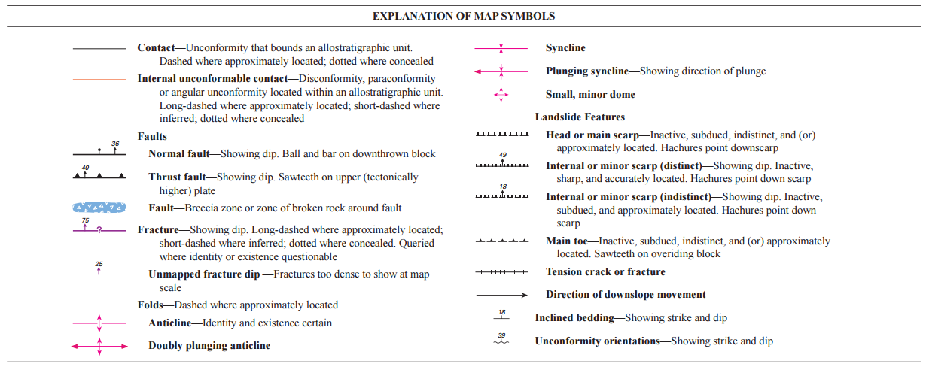
Mechanisms
Candor Chasma pic http://nssdc.gsfc.nasa.gov/imgcat/html/object_page/vom_nj05s070.html

Slide 8
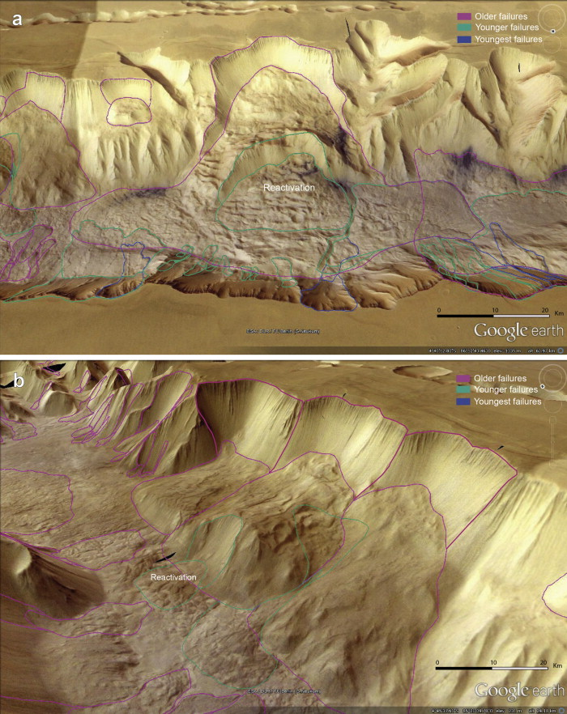
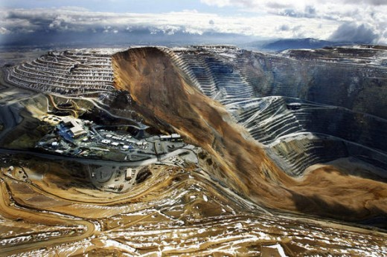
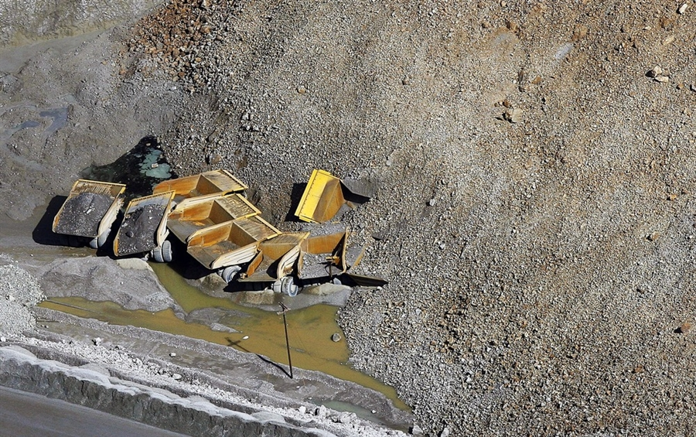
Slope failures on Mars
Size
Typical slope failure could be 100s of cubic Km
Kennecott was 0.07 cubic Km
3.5 billion to 50 million years old
They can trace newer slides
Notes:
Not much weathering so this probably what it looked like right after the slide

Slide 9
Failure Mechanisms

Slide 10
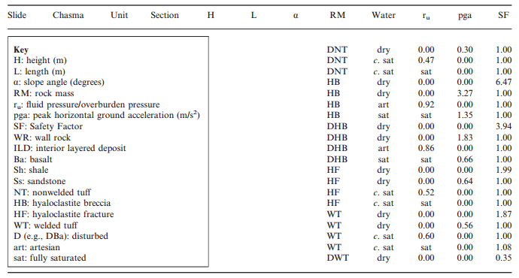
Factors of Safety
Slope stability analysis
Back calculate soil properties, FS 1, topographical data
FS contours Schultz neuffer mechanisms of slope failure

Slide 11
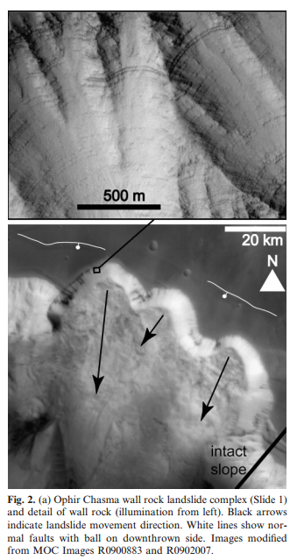
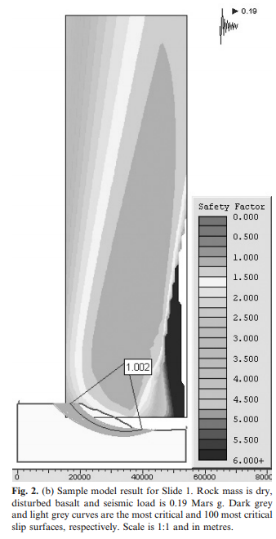
Analysis
Notes:
Left picture shows the scarps
Right shows the analysis similar to Utexas
Back calculate for soil properties

Slide 12
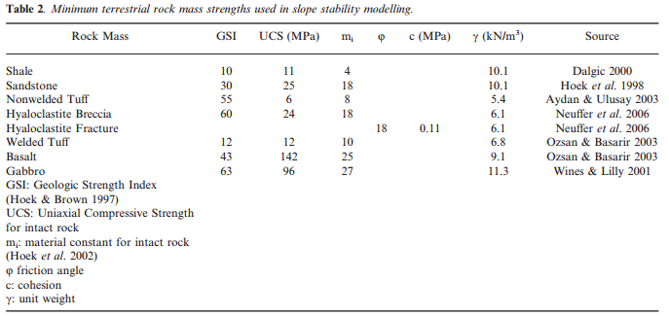
Soil Properties

Slide 13
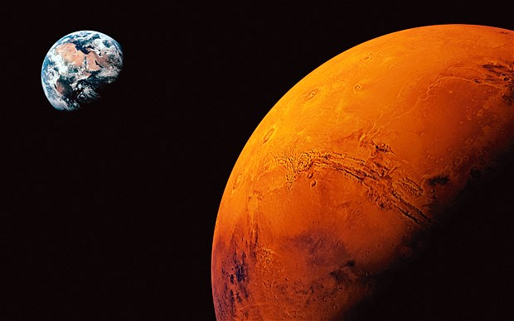
Questions?

